Slide 1
Readmission Analysis Dashboards for Synthea EHR Dataset
Presented By
Bkhrist

Slide 2
Project Objective
Analyse hospital readmissions using synthetic EHR data.
Identify preventable patterns and high-risk groups.
Improve care quality and reduce costs.
Build interactive Power BI dashboards.

Slide 3
Table of Contents
Project Objective
Tools & Technologies
Data Source & Preparation
Data Model & Structure
Dashboard 1 – Patient Overview
Dashboard 2 – Encounter Analysis
Dashboard 3 – Insurance & Financial Impact
Interactivity & User Experience
Key Insights
Conclusion & Impact

Slide 4
Tools & Technologies
Power BI – Dashboard development & interactivity
SQL – Data querying & cleaning
Microsoft Excel – Lightweight data review
Synthea – Synthetic patient data generator

Slide 5
Data Source & Preparation
Data Source:
Synthea (synthetic EHR data)
Generated: 10,000 patients via terminal command
Output: CSVs including Patient, Encounter, Condition, etc.
Cleaning:
Standardized date formats
Filtered valid encounters
Created readmission tracking views

Slide 6
Data Model & Structure
Tables: Patient, Encounter, Condition, Medication, Claim, Claim_Transaction, Payers
Relationships: Star schema (1:Many between patients and others)
Calculated Tables: ReadmissionFlags, ReadmissionParameter, DateTable

Slide 7
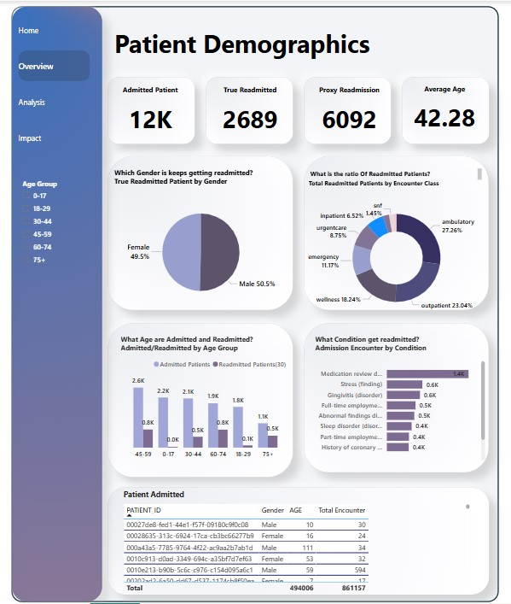
Patient Overview
Purpose:
Profile patient demographics and readmission risk
Key Metrics:
AdmittedPatients
ReadmittedPatients_30days
Readmission by Age Group & Condition
Insight:
Older patients (60+) → higher readmission rates.
Medication review due(situation) Conditions description had highest true readmission

Slide 8
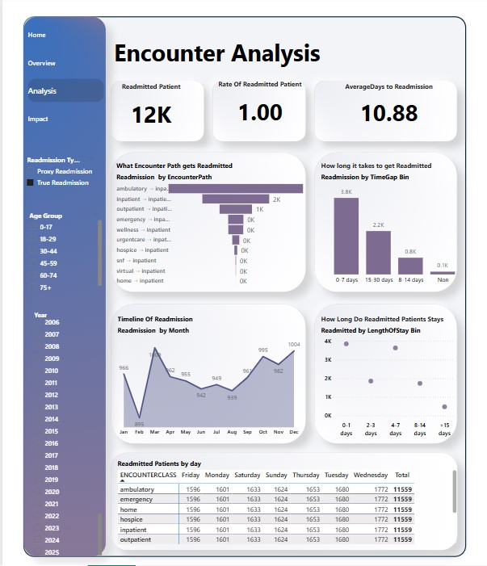
ENCOUNTER ANALYSIS
Purpose:
Understand encounter flow and readmission triggers
Key Metrics:
Trend by encounter type
Funnel from initial to readmission
Stay duration vs. readmission
Insight:
Emergency visits often precede inpatient readmissions. Peaks in March & December.

Slide 9
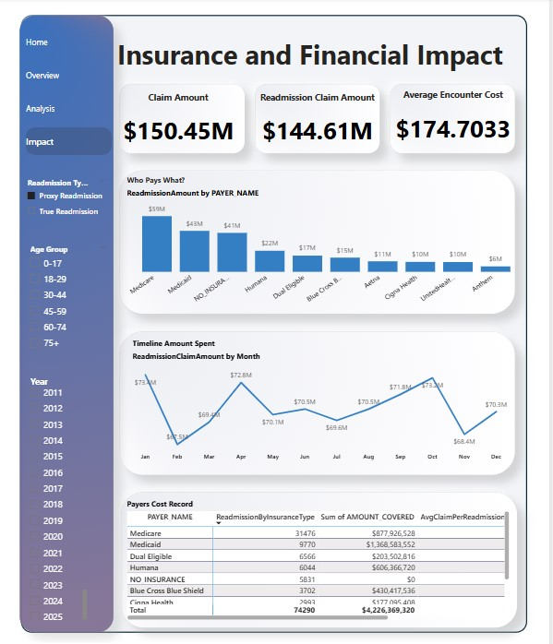
INSURANCE IMPACT
Purpose:
Quantify financial cost of readmissions
Metrics:
ReadmissionClaimAmount
AvgClaimPerReadmission
Unpaid Balances by Insurance Type
Insight:
Medicare has higher emergency readmissions and pays more.
Uninsured patients → highest unpaid balances.

Slide 10
Interactivity & User Experience
Cross-filter by Readmission Type (True vs. Proxy)
Slicers for Date & Readmission Type
Linked visuals across dashboards

Slide 11
Insights and Impact
Ambulatory visits often lead to inpatients (True Admission)
Certain Encounterclass had shorter discharge → readmit gaps.
Medication review due(situation) Conditions description had highest true readmission.
The highest stay of patients is 0-7days

Slide 12
CONCLUSION
Identifies at-risk groups (60+, Medicare), supports financial assistance for self-pay patients/ Introduce them to health insurance
Enhances patient care, optimizes resource allocation, and drives equitable financial management.

Slide 13
THANK YOU
OLADOKUN ABISOLA CHRISTIANA www.linkedin.com/in/oladokun-abisola-ab92482a8

